Slide 1
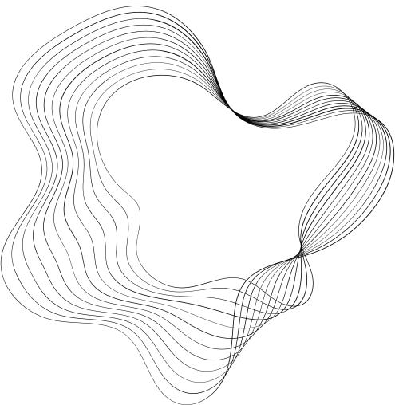

ULTRASONIC DISTANCE SCANNER WITH ARDUINO
MANISHA SHARMI M (210701146)
LAVANYA A (210701132)
MEGHA VARSHINEE S J (210701156)

Slide 2
INTRODUCTION AND PURPOSE OF THE PROJECT
Robotic systems and automation are increasingly prevalent in various fields such as industrial automation, navigation, and environmental monitoring. This project aims to create a simple yet effective mechanism to measure distances using an ultrasonic sensor mounted on a servo motor. The primary goal is to enable the system to scan its surroundings and detect obstacles by measuring distances over a specified angular range. This capability is fundamental for applications such as autonomous navigation, collision avoidance, and environment mapping.

Slide 3
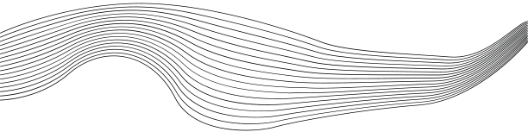
COMPONENTS USED
01
ARDUINO BOARD
02
ULTRASONIC SENSOR(HC-SR04)
03
SERVO MOTOR(SG90)
04
CONNECTING WIRES
05
BREADBOARD
06
POWER SUPPLY

Slide 4
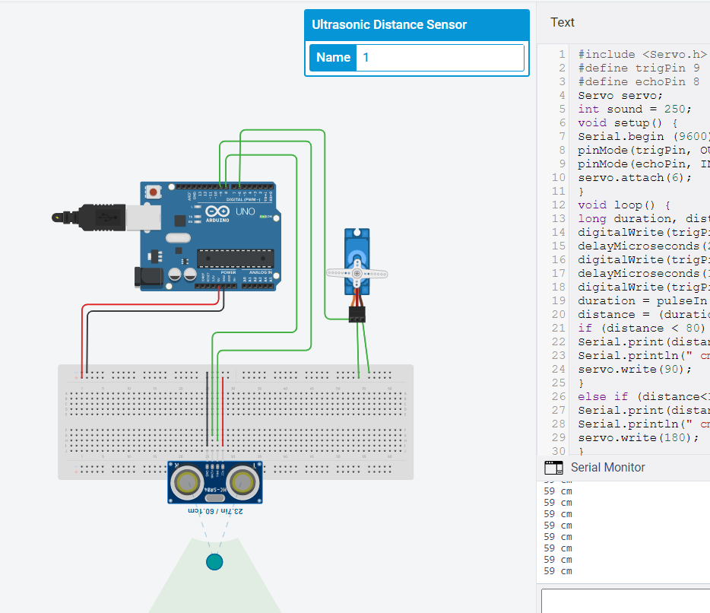
CIRCUIT DIAGRAM

Slide 5
RESULT
The project successfully implemented a scanning mechanism using a servo motor and an ultrasonic sensor. The system rotates the sensor from 15 to 165 degrees and back, capturing distance measurements at each degree. The measured distances are transmitted via serial communication to a connected computer for visualization. The output shows the angular position and corresponding distance, demonstrating the system's ability to detect and map the surrounding environment effectively.

Slide 6
CONCLUSION
This project demonstrates a simple yet effective method for environmental scanning using an Arduino, a servo motor, and an ultrasonic sensor. The system can measure distances within a 180-degree arc and transmit the data for further analysis. The successful implementation highlights the potential for using such a system in applications like autonomous navigation and obstacle detection.

Slide 7
FUTURE SCOPE
The project can be expanded and enhanced in several ways:
Integration with More Sensors: Adding other types of sensors (e.g., infrared, LIDAR) for more comprehensive environmental data.
Real-Time Data Visualization: Developing software to visualize the scanned data in real-time on a computer or mobile device.
Autonomous Navigation: Implementing algorithms that allow a robot to navigate autonomously using the scanned data for obstacle avoidance.
Wireless Communication: Incorporating wireless modules (e.g., Bluetooth, Wi-Fi) to transmit data without the need for direct serial communication.
Advanced Mapping Techniques: Utilizing SLAM (Simultaneous Localization and Mapping) algorithms for creating detailed maps of unknown environments.
By implementing these enhancements, the system can be made more robust and suitable for a wider range of applications in robotics and automation.

Slide 8

THANK YOU

